Slide 1
DIGITAL IMAGE PROCESSING

Slide 2
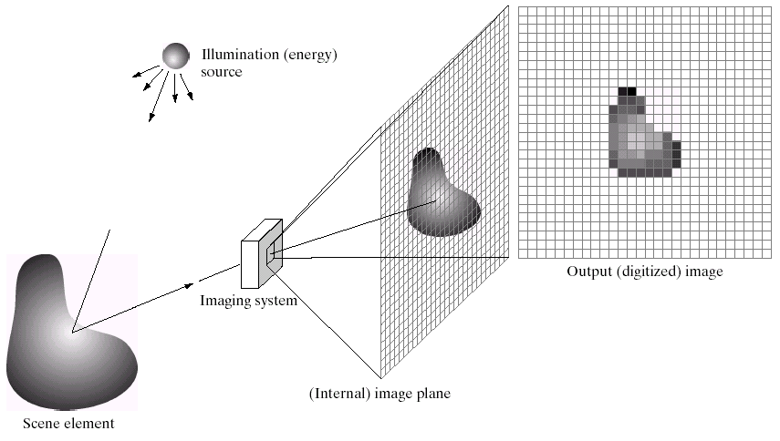
What is a Digital Image?
A digital image is a representation of a two-dimensional image as a finite set of digital values, called picture elements or pixels

Slide 3
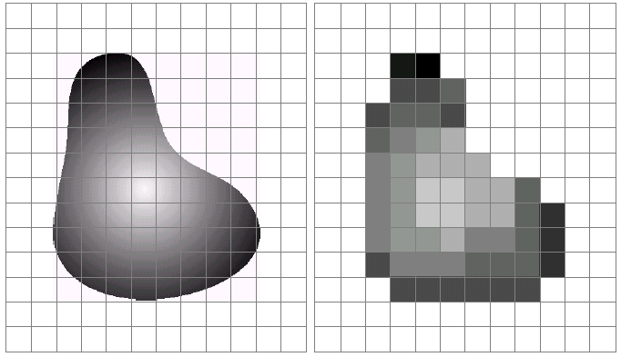
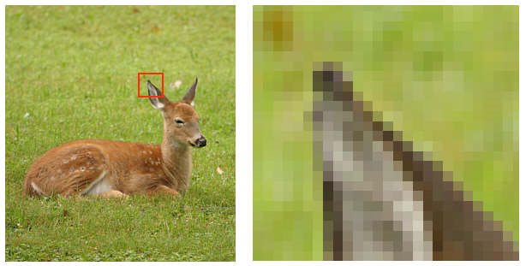
What is a Digital Image?
Pixel values typically represent gray levels, colours, opacities etc…
Digitization implies that a digital image is an approximation of a real scene
1 pixel

Slide 4
What is a Digital Image?
An image is nothing more than a two-dimensional signal. It is defined by the mathematical function f(x,y) where x and y are the two co-ordinates horizontally and vertically.
1 pixel

Slide 5
What is a Digital Image?
The value of f(x,y) at any point is the pixel value at that point of an image.
1 pixel

Slide 6
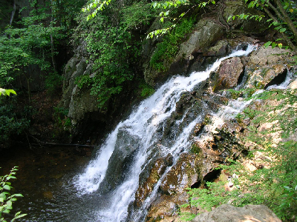

What is a Digital Image?
Common image formats include:
1 sample per point (B&W or Grayscale)
3 samples per point (Red, Green, and Blue)
4 samples per point (Red, Green, Blue, and “Alpha”, a.k.a. Opacity)

Slide 7
What is a Digital Image Processing?
DIP→deals with developing a digital system that performs operations on a digital image
Digital image processing focuses on two major tasks
Improvement of pictorial information for human interpretation
Processing of image data for storage, transmission and representation for autonomous machine perception

Slide 8
What is a Digital Image Processing?
DIP vs COMPUTER VISION
Low Level Process
Mid Level Process
High Level Process
Input: Image Output: Image
Examples: Noise removal, image sharpening
Input: Image Output: Attributes
Examples: Object recognition, segmentation
Input: Attributes Output: Understanding
Examples: Scene understanding, autonomous navigation

Slide 9
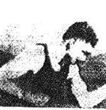
History of Digital Image Processing
The very first image that has been transmitted over the wire
LONDON → NEW YORK
Submarine cable
three hours

Slide 10
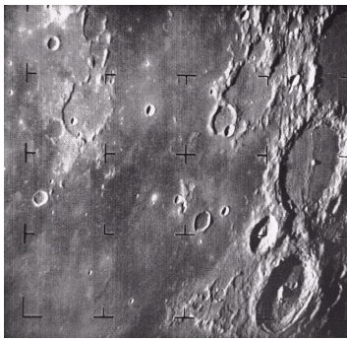
History of Digital Image Processing
1960s: Improvements in computing technology and the onset of the space race led to a surge of work in digital image processing
1964: Computers used to improve the quality of images of the moon taken by the Ranger 7 probe
Such techniques were used in other space
missions including the Apollo landings
A picture of the moon taken by the Ranger 7 probe minutes before landing

Slide 11
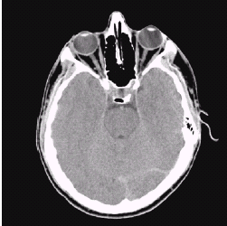
History of Digital Image Processing
1970s: Digital image processing begins to be used in medical applications
1979: Hounsfield & Cormack share the Nobel Prize in medicine for the invention of tomography, the technology behind Computerised Axial Tomography (CAT) scans
Typical head slice CAT image

Slide 12
History of Digital Image Processing
1980s - Today: The use of digital image processing techniques has exploded and they are now used for all kinds of tasks in all kinds of areas
Image enhancement/restoration
Artistic effects
Medical visualisation
Industrial inspection
Law enforcement
Human computer interfaces

Slide 13
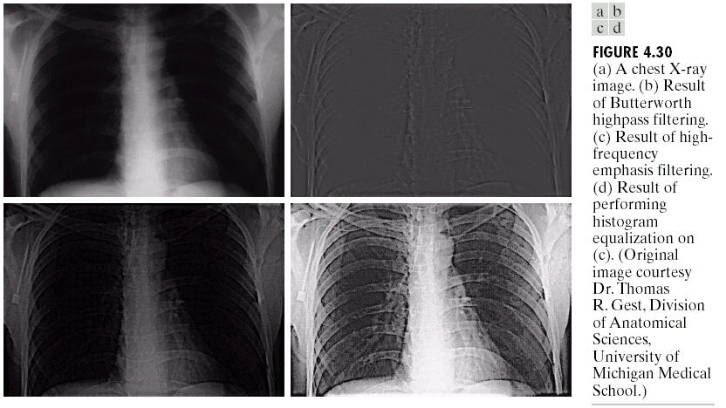
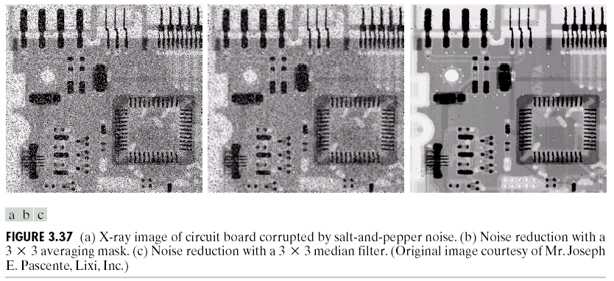
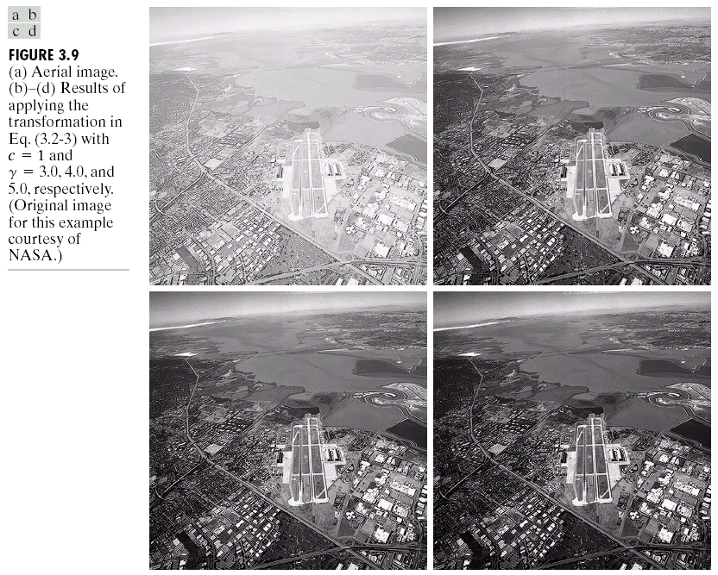
IMAGE ENHANCEMENT
DIP → quality improvement & noise removal

Slide 14
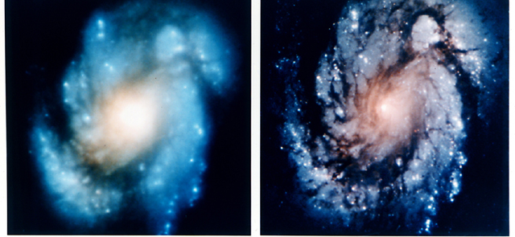
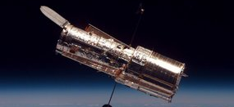
IMAGE ENHANCEMENT
DIP → quality improvement & noise removal
Launched in 1990 the Hubble telescope can take images of very distant objects
However, an incorrect mirror made many of Hubble’s images useless
Image processing techniques were used to fix this

Slide 15
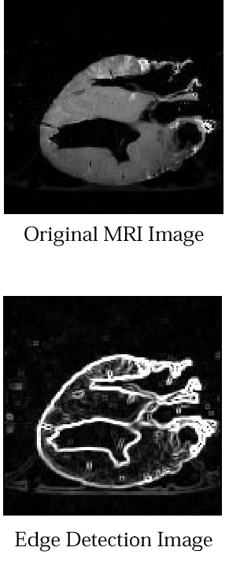
EDGE DETECTION
a suitable filter to highlight edges
gray levels representing tissue density
Original MRI Image of a Dog Heart
Edge Detection Image

Slide 16
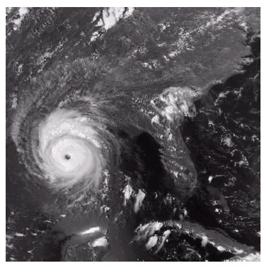
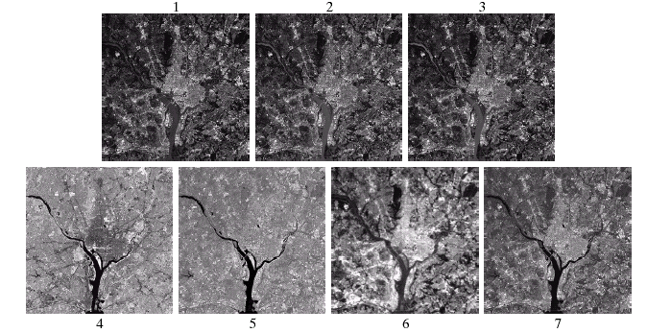
In GIS (GEOGRAPHIC INFORMATION SYSTEMS)
Digital image processing techniques are used extensively to manipulate satellite imagery
Terrain classification
Meteorology

Slide 17
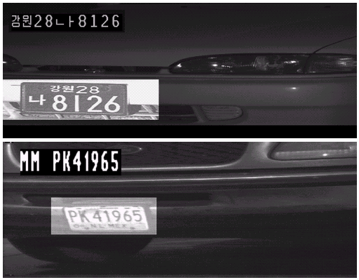
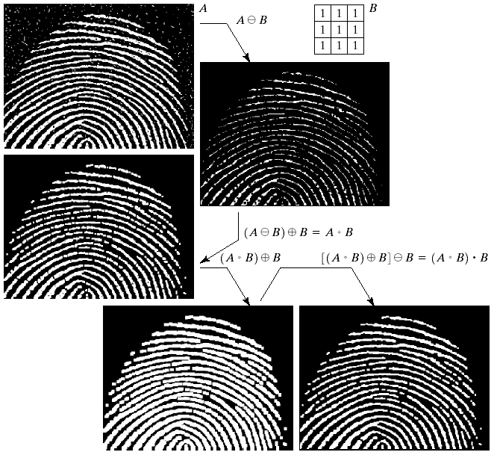
In LAW ENFORCEMENT
Image processing techniques are used extensively by law enforcers
Number plate recognition for speed cameras/automated toll systems
Fingerprint recognition

Slide 18
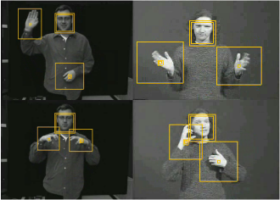

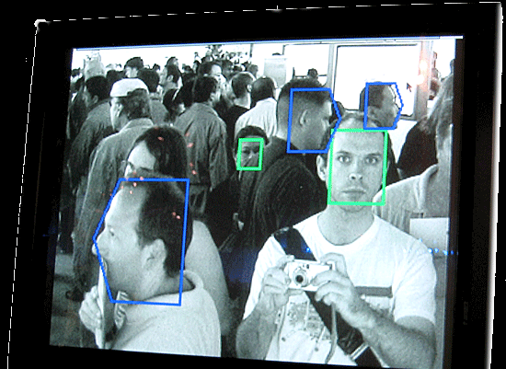
In OTHER AREAS
Face recognition
Gesture recognition

Slide 19
In PATTERN RECOGNITION
Pattern recognition
involves studies from image processing and from various other fields especially machine learning
image processing is used for identifying the objects in an image
and then machine learning is used to train the system for the change in pattern
HOWEVER, CNNs changed image processing forever!
automatic feature extraction
Edges

Slide 20

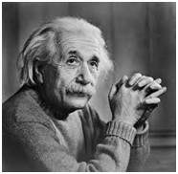
Concept of Pixel
Pixel (PEL)
the smallest element of an image (matrix)
Each pixel corresponds to one value
In an 8-bit gray-scale image, the value of the pixel ranges between 0 and 255.
The value of a pixel at any point corresponds to the intensity of the light
ZOOM

Slide 21
Concept of Pixel
Calculation of total number of pixels
Image → matrix
Total number of pixels = number of rows * number of columns
the number of (x,y) coordinate pairs make up the total number of pixels

Slide 22
Concept of Pixel
The value of the pixel at any point denotes the intensity of image at that location → GRAY LEVEL
Bpp or bits per pixel → the number of bits per pixel
The number of different colours in an image ← on the depth of colour or bits per pixel.
How many numbers can be represented by one bit?
0 & 1
How many numbers can be represented by two bits?
0,1,2,3

Slide 23
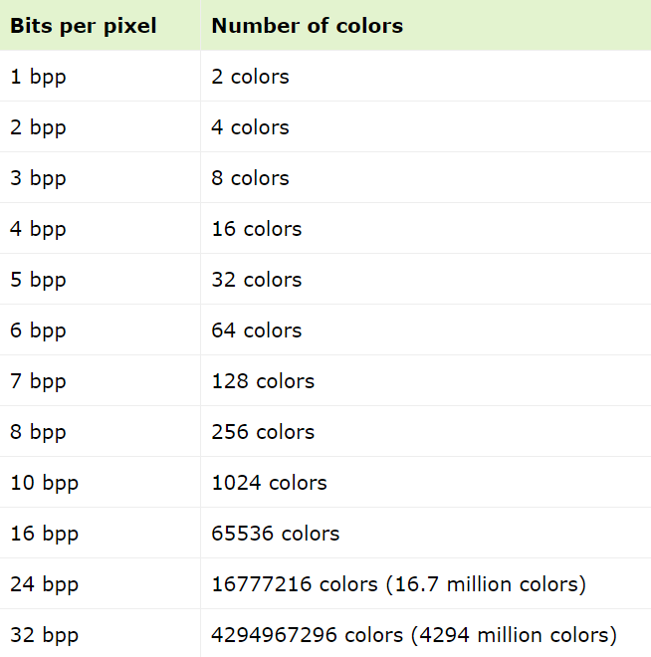
Concept of Pixel
2^{bpp}
If bpp=1 then
image → black & white
Exponential Growth

Slide 24

Concept of Pixel
0 pixel value always denotes black colour
there is no fixed value that denotes white colour
In case of 1 bpp, 0 denotes black, and 1 denotes white.
In case 8 bpp, 0 denotes black, and 255 denotes white.

Slide 25
Image storage requirements
The size of an image → three params
Number of rows
Number of columns
Number of bits per pixel
Size of an image = rows * cols * bpp
Assume that the following 8-bit gray-scale image has 1024 rows & 1024 cols.
Size = 1024*1024*8 = 8388608 bits = 1,048,576 bytes = 1024 KB = 1 MB

Slide 26
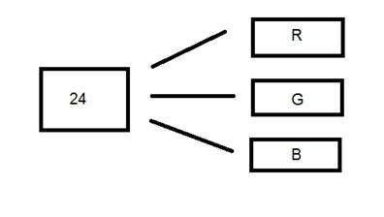
24 bit Colour Format
24 bit colour format → true colour format
it is distributed equally between three different colour channels
8 bits for R, 8 bits for G, 8 bits for B
Unlike a 8 bit gray scale image, which has one matrix, a 24 bit image has three different matrices of R, G, B.

Slide 27
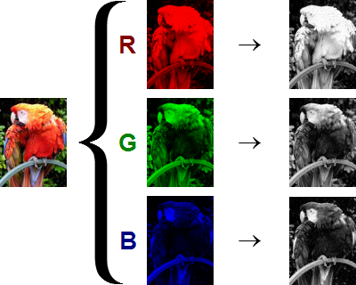
24 bit Colour Format

Slide 28
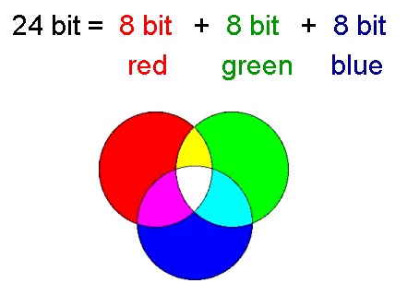
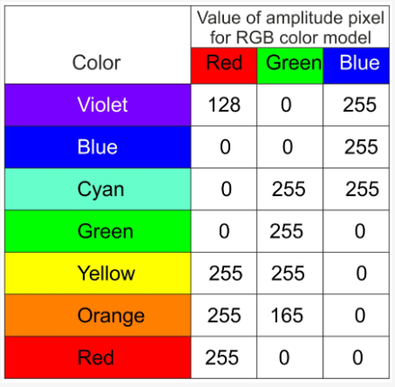
24 bit Colour Format
How many possible colours can be represented with the 24-bit RGB model?

Slide 29
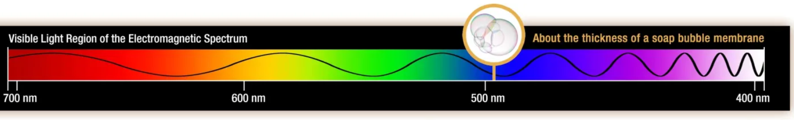
VISIBLE LIGHT
The visible light spectrum → the segment of the electromagnetic spectrum that the human eye can view.
More simply, this range of wavelengths is called visible light.
Typically, the human eye can detect wavelengths from 380 to 700 nanometers.

Slide 30
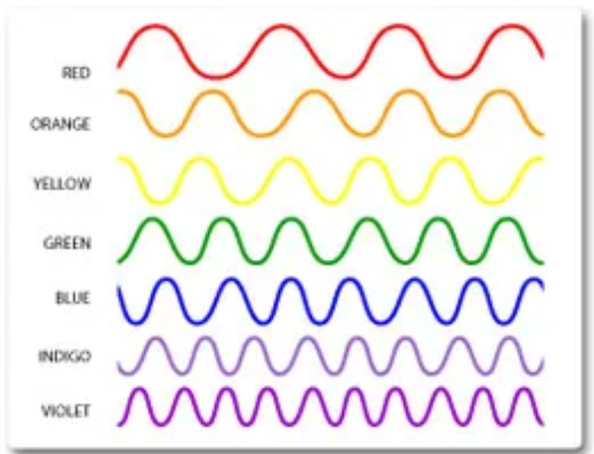
VISIBLE LIGHT
Which one has the most energy?

Slide 31
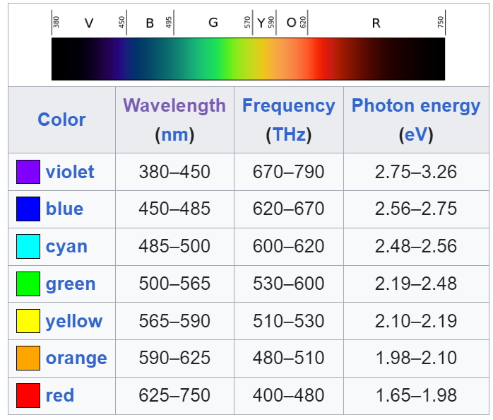
VISIBLE LIGHT
Which one has the most energy?

Slide 32
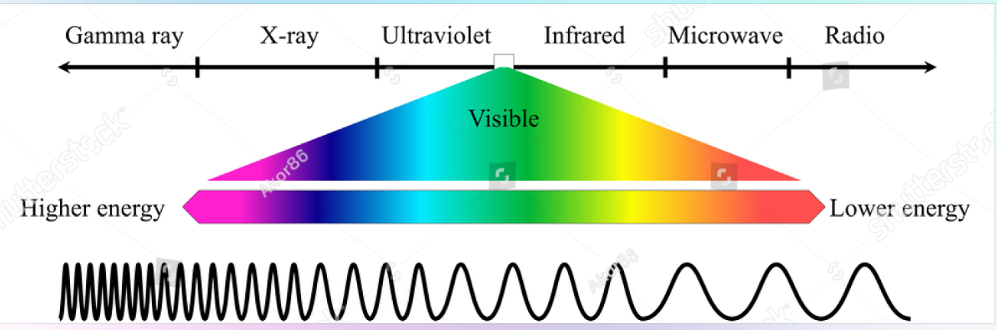
EM SPECTRUM (ELECTROMAGNETIC SPECTRUM)

Slide 33
EM SPECTRUM (ELECTROMAGNETIC SPECTRUM)
The electromagnetic (EM) spectrum is the range of all types of EM radiation.
Radiation is energy that travels and spreads out as it goes
– the visible light that comes from a lamp in your house and
the radio waves that come from a radio station are two types of electromagnetic radiation.
The other types of EM radiation that make up the electromagnetic spectrum are microwaves, infrared light, ultraviolet light, X-rays and gamma-rays.
Radio waves, gamma-rays, visible light, and all the other parts of the electromagnetic spectrum are electromagnetic radiation.

